Slide 1
KNK ERP
KNK ERP
Compare against list fetched from KNK at start of stock take
Option to take photos of any of the items
Expected serials are known at start of stock take but not shown
Enter any comments against the stock take
Scan all serials in the shop that can be found
Go back to scan more if needed (from the missing ones)
Start stock take
Scan in serials
Validation results
Expected (2)
Serial X
Serial Y
Not expected (2)
Serial A
Serial B
Missing (1)
Serial M
Finished
Enter comments
Get all cookers recorded at that shop
Submit stock take results
Scan more
Scan
Validate
Finished
Submit

Slide 2
Actions on stock take data
Serial ID | Stock take status | Actions
3000100234 | [!] [?] | [move] [transfer]
3000100232 | [!] | [move] [transfer]
3000100292 | [?] | [scrap]
Stock take status:
[!] = stock found at wrong location
[?] = stock missing from expected location
Actions:
[move] = create task to move item from found location to expected location
[transfer] = adjust stock records in odoo to match stock take result
[scrap] = write off item from system

Slide 3
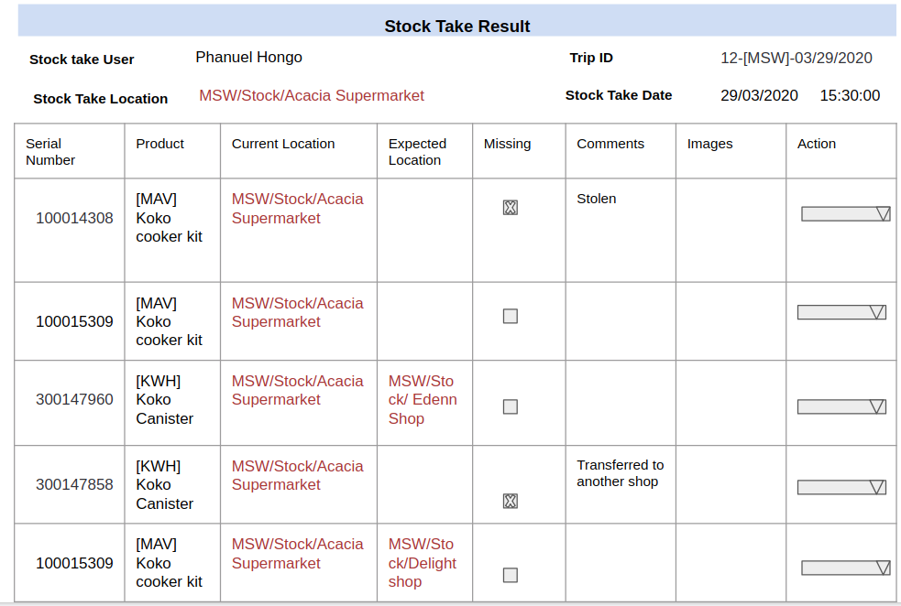

Slide 4
Stock Take Result
Serial Number | Product | Stock Take Location | Expected Location | Status | Comments | Images | Stock Take Date | Trip ID | Stock Take User
100014308 | [MAV] Koko cooker kit | MSW/Stock/Acacia Supermarket |  |  | Stolen
100015309 | [MAV] Koko cooker kit | MSW/Stock/Genesis Uthiru-2
300147960 | [KWH] Koko Canister | MSW/Stock/ Mashtec gas | MSW/Stock/ Edenn Shop
300147858 | [KWH] Koko Canister | MSW/Stock/Acacia Supermarket |  |  | Transferred to another shop
100015309 | [MAV] Koko cooker kit | MSW/Stock/Agape gas Centre | MSW/Stock/Delight shop
Notes:
Notes:
Current Location- by default it will pick the scanned location
Expected location - the correct location where the product should be. This will remain blank if the item is where it’s supposed to be
Status- This will show the results of the scan (expected, not expected and missing)
Missing - Items expected to be at that location but not there or anywhere in the system. The read-only checkbox will be marked if the item is missing otherwise it will remain blank
Comments - Reasons provided for missing products
Images - Any image taken

Slide 5
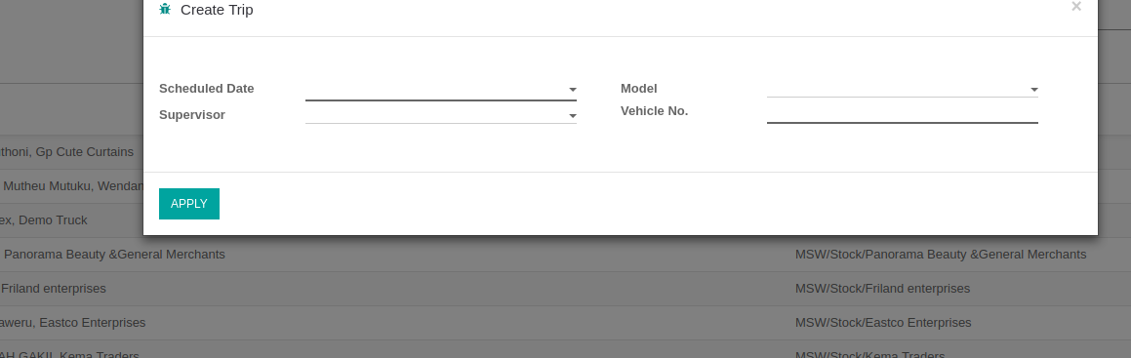

Slide 6
Stock Take Result
Serial Number | Product | Stock Take Location | Expected Location | Status | Comments | Images | Stock Take Date | Trip ID | Stock Take User
100014308 | [MAV] Koko cooker kit | MSW/Stock/Acacia Supermarket |  |  | Stolen
100015309 | [MAV] Koko cooker kit | MSW/Stock/Genesis Uthiru-2
300147960 | [KWH] Koko Canister | MSW/Stock/ Mashtec gas | MSW/Stock/ Edenn Shop
300147858 | [KWH] Koko Canister | MSW/Stock/Acacia Supermarket |  |  | Transferred to another shop
100015309 | [MAV] Koko cooker kit | MSW/Stock/Agape gas Centre | MSW/Stock/Delight shop
Notes:
Notes:
Current Location- by default it will pick the scanned location
Expected location - the correct location where the product should be. This will remain blank if the item is where it’s supposed to be
Status- This will show the results of the scan (expected, not expected and missing)
Missing - Items expected to be at that location but not there or anywhere in the system. The read-only checkbox will be marked if the item is missing otherwise it will remain blank
Comments - Reasons provided for missing products
Images - Any image taken

Slide 7
User Action after Investigations
Stock Take Result
Stock take User
Phanuel Hongo
Trip ID
12-[MSW]-03/29/2020
Stock Take Location
MSW/Stock/Acacia Supermarket
Stock Take Date
29/03/2020 15:30:00
Serial Number | Product | Stock TakeLocation | Expected Location | Missing | Comments | Images | Action
100014308 | [MAV] Koko cooker kit | MSW/Stock/Acacia Supermarket |  |  | Stolen
100015309 | [MAV] Koko cooker kit | MSW/Stock/Acacia Supermarket
300147960 | [KWH] Koko Canister | MSW/Stock/Acacia Supermarket | MSW/Stock/ Edenn Shop
300147858 | [KWH] Koko Canister | MSW/Stock/Acacia Supermarket |  |  | Transferred to another shop
100015309 | [MAV] Koko cooker kit | MSW/Stock/Acacia Supermarket | MSW/Stock/Delight shop
Notes:
Notes:
Investigations will be conducted on product serials that have discrepancies and recommended actions taken.
On selecting a serial checkbox, the ‘Action’ drop-down box will pop-up at the top for the user to select appropriate action
i.e a) Send to expected location b)Scrap lost/missing product c)Update based on stock-take result

Slide 8
SAVE
ICA 001: Transfer to Stock Take Location
Stock take location
MSW/Stock/Acacia Supermarket
Date
28/03/2020
Final location
MSW/Stock/Delight Shop
User
Cedric Mbai
Product | UOM | Serial Number
[MAV] Koko cooker kit | Units | 100015309
[KWH] Koko Canister | Units | 300147858
Notes:
Internal transfer done on recommendations of investigations committee
This transaction would effect the stock move to stated location
Notes:
Notes:
ICA 001- means Investigation Corrective action sequence
Upon filling the details in this form, an email will be triggered to the approvers to approve the action and the stock transfer would happen

Slide 9
Approval Matrix
Designation | Name | Sequence | Approve/Reject
Distribution & Services Manager | Hezbon Kogollah | 1 | Approved
General Manager | Matt Schiller | 2 | Approved

Slide 10
Serial Number | Product | Stock TakeLocation | Expected Location | Missing | Comments | Images | Action
100014308 | [MAV] Koko cooker kit | MSW/Stock/Acacia Supermarket |  |  | Stolen
100015309 | [MAV] Koko cooker kit | MSW/Stock/Acacia Supermarket
300147960 | [KWH] Koko Canister | MSW/Stock/Acacia Supermarket | MSW/Stock/ Edenn Shop
300147858 | [KWH] Koko Canister | MSW/Stock/Acacia Supermarket |  |  | Transferred to another shop
100015309 | [MAV] Koko cooker kit | MSW/Stock/Acacia Supermarket | MSW/Stock/Delight shop

Slide 11
Stock Take Result
Stock take User
Phanuel Hongo
Trip ID
12-[MSW]-03/29/2020
Stock Take Location
MSW/Stock/Acacia Supermarket
Stock Take Date
29/03/2020 15:30:00
Serial Number | Product | Stock Take Location | Expected Location | Missing | Comments | Images | Action
100014308 | [MAV] Koko cooker kit |  |  |  | Stolen
100015309 | [MAV] Koko cooker kit | MSW/Stock/Acacia Supermarket
300147960 | [KWH] Koko Canister | MSW/Stock/Acacia Supermarket | MSW/Stock/ Edenn Shop
300147858 | [KWH] Koko Canister |  |  |  | Transferred to another shop
100015309 | [MAV] Koko cooker kit | MSW/Stock/Acacia Supermarket | MSW/Stock/Delight shop
Notes:
Notes:
Investigations will be conducted on product serials that have discrepancies and recommended actions taken.
On selecting a serial checkbox, the ‘Action’ drop-down box will pop-up at the top for the user to select appropriate action
i.e a) Send to expected location b)Scrap lost/missing product c)Update based on stock-take result

Slide 12
SAVE
ICA 001: Scrap Stock
Stock take location
MSW/Stock/Acacia Supermarket
Date
28/03/2020
Final location
Virtual location/ scrapped
User
Cedric Mbai
Product | UOM | Serial Number
[MAV] Koko cooker kit | Units | 100015309
[KWH] Koko Canister | Units | 300147858
Notes:
Item (s) scrapped on recommendations of investigations committee
This transaction would effect the stock move to stated location
Notes:
Notes:
ICA 001- means Investigation Corrective action sequence
Upon filling the details in this form, an email will be triggered to the approvers to approve the action and the stock transfer would happen

